Slide 1
Travelling salesman problem
The travelling salesman problem is ‘find a route of minimum length which visits every vertex in an undirected network’.
There is no known method for solving this problem, only a combination of algorithms that find a range of values for the best route:
Smaller bound better
Upper bound
Nearest neighbour algorithm
or
2 x MST - shortcuts
Optimal solution
Bigger bound better
Lower bound
RMST + reconnectors

Slide 2
Upper bound: Nearest Neighbour Algorithm
Eg Starting at B, use the nearest neighbour algorithm to obtain an upper bound for the length of the route.
The Nearest neighbour algorithm finds a tour by choosing the shortest arc from the last node chosen to an unconnected node each time.
B
C
E
G
F
D
A
B
Starting at different nodes can lead to shorter and therefore more optimal solutions to the travelling salesman problem.
90
110
82
63
105
280
165
Total weight = 895
Starting at C, use the nearest neighbour algorithm to obtain another upper bound for the length of the route.
 | A | B | C | D | E | F | G
A | - | 165 | 195 | 280 | 130 | 200 | 150
B | 165 | - | 90 | 155 | 150 | 235 | 230
C | 195 | 90 | - | 170 | 110 | 175 | 190
D | 280 | 155 | 170 | - | 150 | 105 | 163
E | 130 | 150 | 110 | 150 | - | 90 | 82
F | 200 | 235 | 175 | 105 | 90 | - | 63
G | 150 | 230 | 190 | 163 | 82 | 63 | -
C
B
E
G
F
D
A
C
90
150
82
63
105
280
195
Total weight = 965
State which is the best upper bound, giving a reason for your answer.
The lower value is better (895)

Slide 3
Upper bound: 2 x MST – shortcuts
Eg An area manager has to visit branches of his company in 7 towns A, B, C, D, E, F and G. The table shows the distances, in km, between these 7 towns. The manager lives in town A and plans a route starting and finishing at this town. She wishes to visit each town and drive the minimum distance.
(a) Starting from A, use Prim’s algorithm to find a minimum connector and draw the minimum spanning tree. State the order in which you selected the arcs.
Arcs selected:
 | A | B | C | D | E | F | G
A | - | 165 | 195 | 280 | 130 | 200 | 150
B | 165 | - | 90 | 155 | 150 | 235 | 230
C | 195 | 90 | - | 170 | 110 | 175 | 190
D | 280 | 155 | 170 | - | 150 | 105 | 163
E | 130 | 150 | 110 | 150 | - | 90 | 82
F | 200 | 235 | 175 | 105 | 90 | - | 63
G | 150 | 230 | 190 | 163 | 82 | 63 | -
AE,
EG,
GF,
FD,
EC,
CB
MST:
A
E
G
F
D
C
B

Slide 4
150
A tour can be found by making each node have even valency.
A
130
82
63
105
E
G
F
D
130
82
63
105
The simplest way to do this is to ‘double up’ the MST
110
110
C
Hence an initial upper bound for a solution to the travelling salesman problem can be found by doubling the length of the MST
90
90
155
B
An improved upper bound can be found by removing arcs from the doubled MST using ‘short-cuts’ identified in the original table of weights
Weight of MST = 580km
So initial upper bound = 1160km
 | A | B | C | D | E | F | G
A | - | 165 | 195 | 280 | 130 | 200 | 150
B | 165 | - | 90 | 155 | 150 | 235 | 230
C | 195 | 90 | - | 170 | 110 | 175 | 190
D | 280 | 155 | 170 | - | 150 | 105 | 163
E | 130 | 150 | 110 | 150 | - | 90 | 82
F | 200 | 235 | 175 | 105 | 90 | - | 63
G | 150 | 230 | 190 | 163 | 82 | 63 | -
BD saves (90+110+82+63+105) -155 = 295
So improved upper bound = 1160 – 295 = 865km
AG saves (130+82) -150 = 62
So improved upper bound = 865 – 62 = 803km

Slide 5
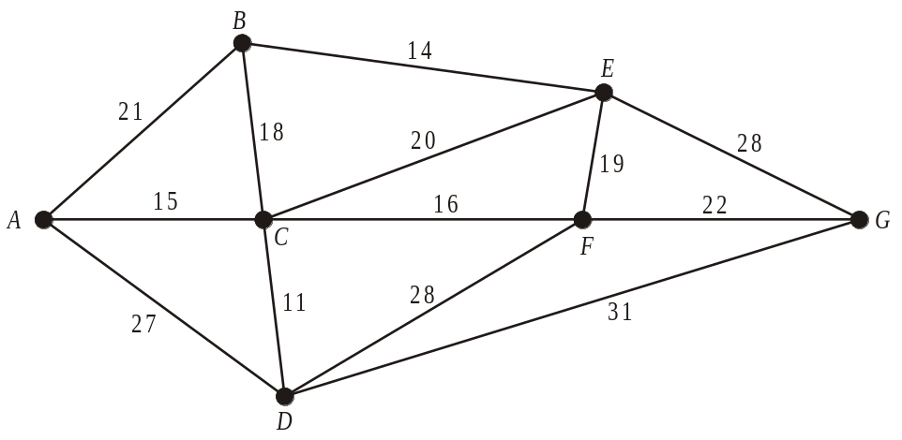
Lower bound: Residual MST + reconnectors
A lower bound can be found using the following algorithm:
Ignore (‘delete’) a node and all arcs connected to it
Find a MST for the remaining nodes (known as the Residual MST)
Reconnect missing node using the 2 shortest possible arcs
Eg delete F
Kruskal gives RMST:
B
14
E
28
18
19
G
A
15
C
16
F
RMST weight = 86
11
D
The algorithm gives a lower bound, as the resulting network could at best give a tour of minimal possible length, but will more likely not give a tour at all.
Reconnect F using FC and FE
Lower bound = 86 + (16+19) = 121

Slide 6
Deleting a different node can lead to a different lower bound
Eg deleting C
Kruskal gives RMST:
B
14
E
21
19
A
15
C
22
F
G
11
27
D
The larger the weight of the resulting network, the more optimal as this reduces the band within which the solution to the travelling salesman problem lies.
RMST weight = 103
Reconnect C using AC and CD
Lower bound = 103 + (11+15) = 129
Lower bound by deleting F was 121
Lower bound by deleting C is 129
Better lower bound is 129

Slide 7

What does the ‘answer’ look like?
Both algorithms for an upper bound (2 x MST – shortcuts and NNA) do give a tour which may be the optimal solution.
If the algorithm for a lower bound (RMST + reconnectors) does not give a tour, this tells you the optimal solution must be bigger.
If this is the case, if x is the optimum length of route, p is the best (largest) lower bound and q is the best (smallest) upper bound, we can say that:
However, if p+1 = q then x = q, as there is no other value for x to take.
Also, if the algorithm for a lower bound gives a tour, an optimal solution has been found to the Travelling Salesman Problem and so x = p
In the exam, you are not likely to find an optimal solution, but instead find a range of values that the optimum route must lie between. At the same time, you should recognise when an optimal solution has been obtained.

Slide 8
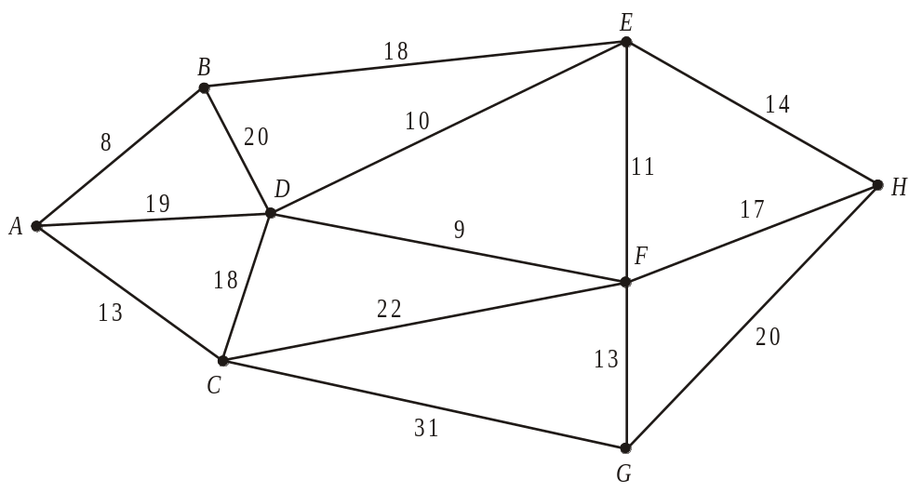














Using Kruskal’s algorithm:
Arc
Include?
AB
DF
DE
EF
AC
, FG
EH
FH
CD
WB1b The network in the diagram above shows the distances, in kilometres, between eight McBurger restaurants. An inspector from head office wishes to visit each restaurant. His route should start and finish at A, visit each restaurant at least once and cover a minimum distance.
(b) Obtain a minimum spanning tree for the network using Kruskal’s algorithm. You should draw your tree and state the order in which the arcs were added.
Length of MST = 85

Slide 9
(c) Use your answer to part (b) to determine an initial upper bound for the length of the route.
Weight of MST = 85
So initial upper bound = 170
(d) Starting from your initial upper bound and using an appropriate method, find an upper bound which is less than 135 km. State your tour.
18
BE saves (8+13+18+10) -18 = 31
Improved upper bound = 170 – 31 = 139
FH saves (9+10+14) -17 = 16
17
Improved upper bound = 139 – 16 = 123
Gives possible tour ABEHFGFDCA

Slide 10
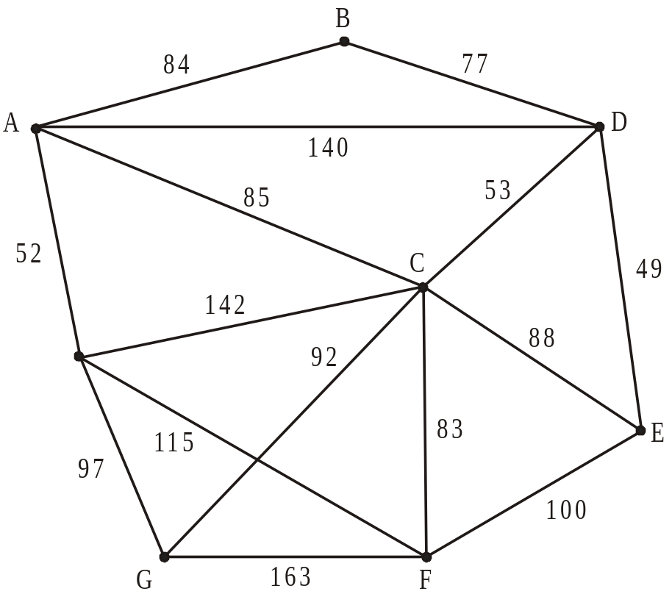
WB2 The network in the figure above, shows the distances in km, along the roads between eight towns, A, B, C, D, E, F, G and H. Keith has a shop in each town and needs to visit each one. He wishes to travel a minimum distance and his route should start and finish at A.
By deleting D, a lower bound for the length of the route was found to be 586 km.
By deleting F, a lower bound for the length of the route was found to be 590 km.
(a) By deleting C, find another lower bound for the length of the route. State which is the best lower bound of the three, giving a reason for your answer.
Kruskal gives RMST:
84
B
77
A
D
53
52
49
C
H
E
83
97
100
H
G
F
RMST weight = 459
Reconnect C using CD and CF
Lower bound = 459 + (53+83) = 595
Highest lower bound is best = 595

Slide 11
(b) By inspection complete the table of least distances.
 | A | B | C | D | E | F | G | H
A | - | 84 | 85 | 138 | 173 |  | 149 | 52
B | 84 | - | 130 | 77 | 126 | 213 | 222 | 136
C | 85 | 130 | - | 53 | 88 | 83 | 92
D | 138 | 77 | 53 | - | 49 |  |  | 190
E | 173 | 126 | 88 | 49 | - | 100 | 180 | 215
F |  | 213 | 83 |  | 100 | - | 163 | 115
G | 149 | 222 | 92 |  | 180 | 163 | - | 97
H | 52 | 136 |  | 190 | 215 | 115 | 97 | -
167
137
136
145
H
167
136
145
137
Fastest route from A to F is via H
Fastest route from C to H is via A
Fastest route from D to F is via C
Fastest route from D to G is via C

Slide 12
The table can now be taken to represent a complete network.
The nearest neighbour algorithm was used to obtain upper bounds for the length of the route: Starting at D, an upper bound for the length of the route was found to be 838 km.
Starting at F, an upper bound for the length of the route was found to be 707 km.
(c) Starting at C, use the nearest neighbour algorithm to obtain another upper bound for the length of the route. State which is the best upper bound of the three, giving a reason for your answer.
 | A | B | C | D | E | F | G | H
A | - | 84 | 85 | 138 | 173 |  | 149 | 52
B | 84 | - | 130 | 77 | 126 | 213 | 222 | 136
C | 85 | 130 | - | 53 | 88 | 83 | 92
D | 138 | 77 | 53 | - | 49 |  |  | 190
E | 173 | 126 | 88 | 49 | - | 100 | 180 | 215
F |  | 213 | 83 |  | 100 | - | 163 | 115
G | 149 | 222 | 92 |  | 180 | 163 | - | 97
H | 52 | 136 |  | 190 | 215 | 115 | 97 | -
C
D
E
F
H
A
B
G
C
53
49
100
115
52
84
222
92
167
Total weight = 767
137
Lowest upper bound is best = 707
136
145
167
136
145
137

